Slide 1
Canvassing Housing

Slide 2
Four Training Resources
IDRC has developed a four-part training series that covers each of the four areas of Balanced Recruitment.
Use the resources to review your current efforts and see if there are any additional areas that you can expand your ID&R efforts.

Slide 3
What is Balanced Recruitment?
For MEP programs to be successful it is necessary to ensure that all areas of the state are thoroughly canvassed through Balanced Recruitment Efforts.
This involves canvassing housing, working to recruit in the community and develop partnerships with community agencies, developing partnerships with farms, fisheries, and agribusinesses as well as working with schools.

Slide 4
What is Balanced Recruitment?
Community Recruitment
Housing
Farms, Fishing, Agribusiness
Schools
All four areas are essential to developing successful Identification and Recruitment Efforts.

Slide 5
What this training covers…
Resources recruiters have access to that can help them find housing locations
Different types of housing visits recruiters can perform.
Tips for how recruiters can help build trust from the moment they knock on the door.

Slide 6
The Importance of Housing Visits
Housing visits are one of the four key areas of Identification and Recruitment.
Visiting migrant workers or potentially eligible students and their families in their homes allows you to have longer conversations in an environment they are comfortable in.

Slide 7
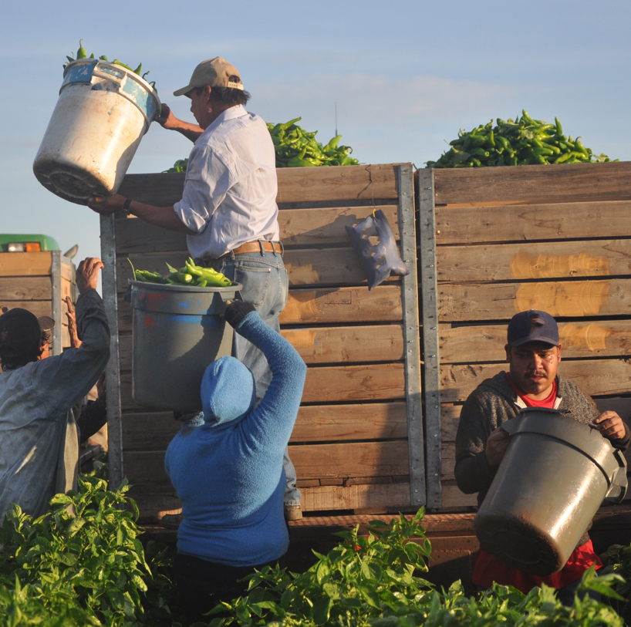
The Importance
of Housing Visits
Many times it can be difficult to properly interview migrant workers or families if you are not taking the time to visit them in their homes.
Housing visits allow you to build rapport with families, helps you build trust, and can lead to obtaining further leads or information.

Slide 8
The Importance of Housing Visits
Migrant workers and their families often stay in the same addresses or areas they are already familiar with. Families who are new to the area will often stay in housing locations that other migrant workers have recommended.
Regularly checking housing locations can help you to be thorough and ensure you are not missing any potential students.

Slide 9
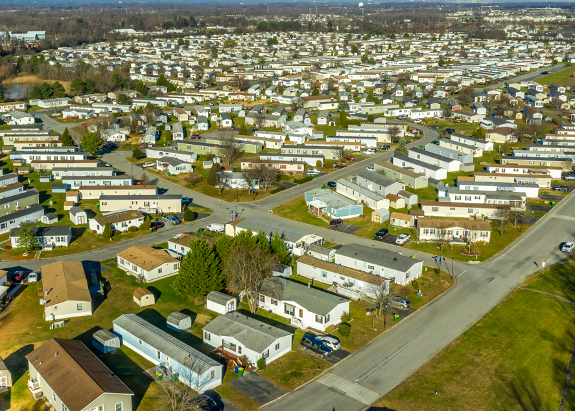
The Importance of Housing Visits
Many potentially eligible students may only be found through housing visits.
Housing visits can help you locate the difficult to find students who qualify for the Migrant Education Program based on previous moves.

Slide 10
What Information
We Want to Learn
When visiting housing locations, recruiters should prioritize learning:
If anyone in the household might be eligible for MEP
If anyone in the household is currently employed at
an agribusiness
If the family has any immediate needs
If the family knows anyone else that might be eligible
If the family knows of any other contacts in the
community you should talk to

Slide 11
What Should You Look For
While out recruiting be sure to keep your eyes out and look for signs that a potentially eligible student or migrant worker may be living there.
A lot of information can be gained by keeping your eyes open and remaining focused on your surroundings. Even while driving you can notice signs that can lead you to finding potentially new housing locations.

Slide 12
What Should You Look For
There are a lot of items that are left outside or around homes that can indicate a potential migrant worker or student is living in the house. Look for:
Agricultural Equipment/Boxes on porch.
Power Lines in fields near farms
Out of state license plates
Foreign language boxes on the porch or in the trash.
Trailers or housing near farm site
White work vans with muddy tires
Box Trucks

Slide 13
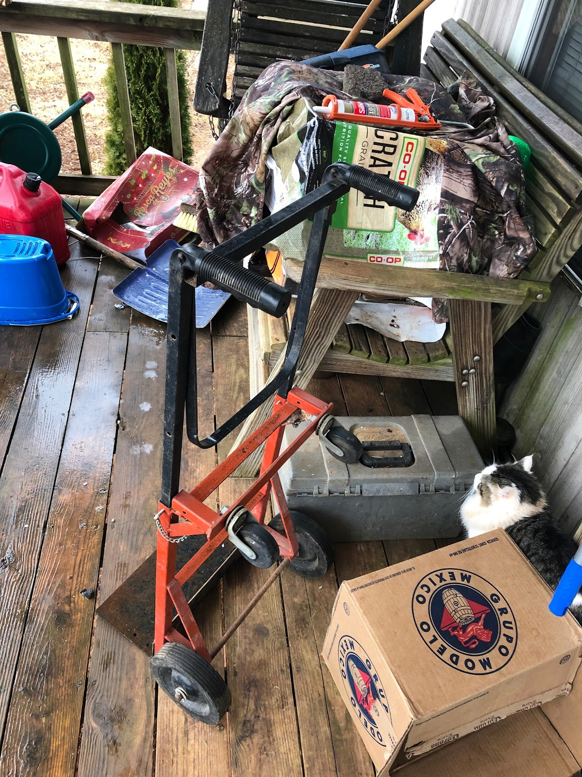
What Should You Look For
/
This is a picture from the porch of a family that was working for a local nursery in Tennessee. The recruiter noticed the house from the road because there was a poster of the Virgin Mary in the window.
After approaching, they noticed boxes of fertilizer and agricultural products, a Rosca de Reyes box in Spanish, and beer from Mexico.
The family was found to be eligible.
Notes:
-the story about the virgin mary poster made me lol
Possibly add things like:
clothes on a drying line, work boots on the porch
Cultural indicators
+any of the aforementioned along with kids things (like toys, shoes, clothes on line, etc)

Slide 14
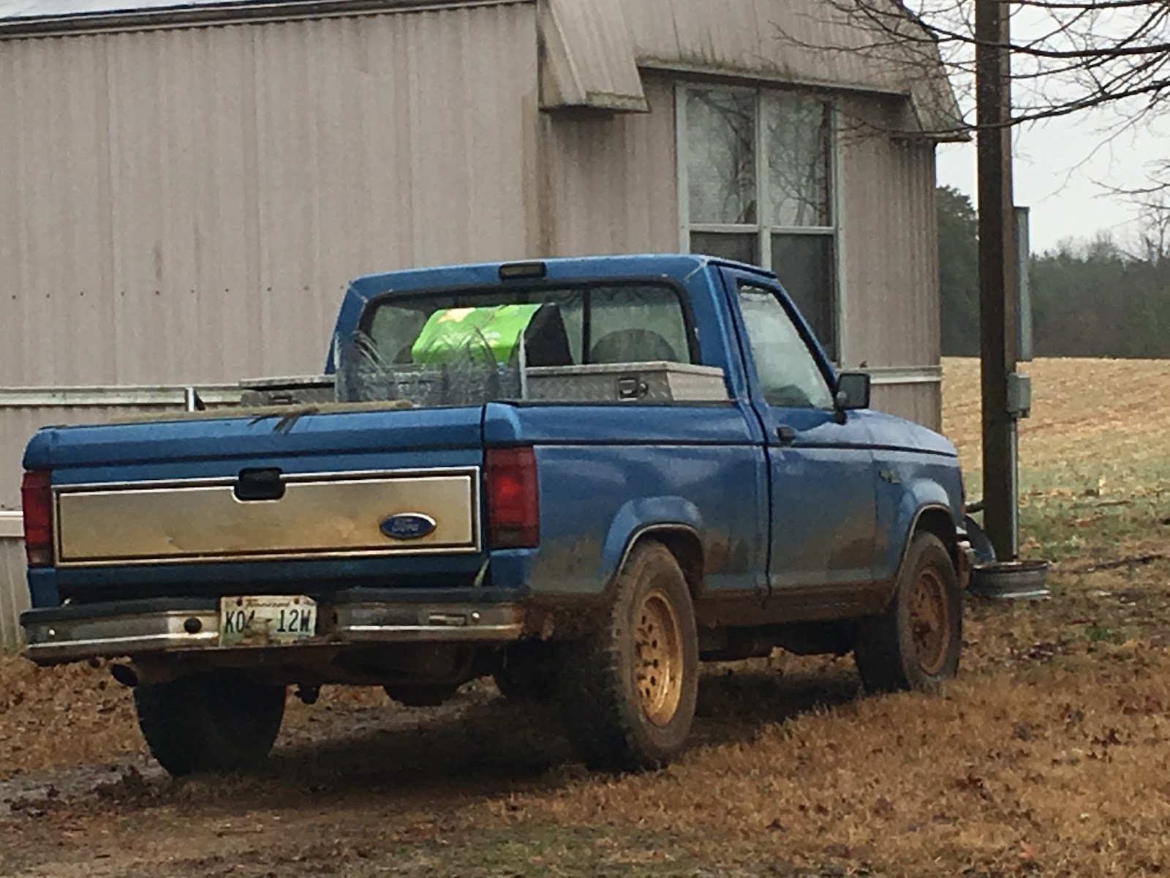
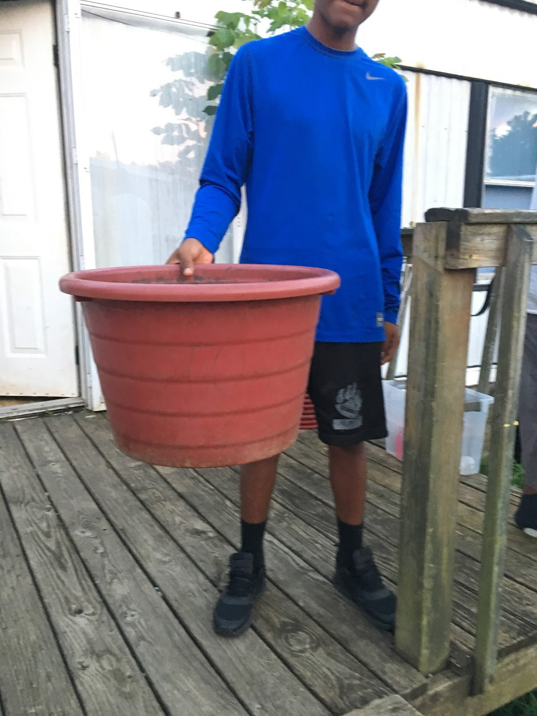
Examples of Agricultural Equipment
The agricultural equipment you may find around housing will differ according to what is being grown or processed in your area. Research what type of equipment is used with crops and the agribusinesses in your recruitment area you will know what to look for.
Baskets used to transplant trees
Tomato bucket

Slide 15
Definition of Housing
According to Question D2 on Page 20 of the Non-Regulatory Guidance, a "residence" is "as a place where one lives and not just visits. In certain circumstances, boats, vehicles, tents, trailers, etc., may serve as a residence."
There is no limits as to what can be considered housing as long as the student is living there.

Slide 16
Four Types of Housing Visits
There are four types of housing visits that can be performed by recruiters:
Visiting farmworker housing
Visiting currently enrolled families
Visiting old addresses
Conducting door-to-door efforts

Slide 17
Visiting Farmworker Housing
Many migrant workers and their families live at housing locations located on or near farms.
While visiting farms and agribusinesses look for trailers or houses where workers may live. Be sure to look close to fields, where crops are grown, or near dairy farms.
Check all possible locations, and ask the business owner if they provide housing.

Slide 18
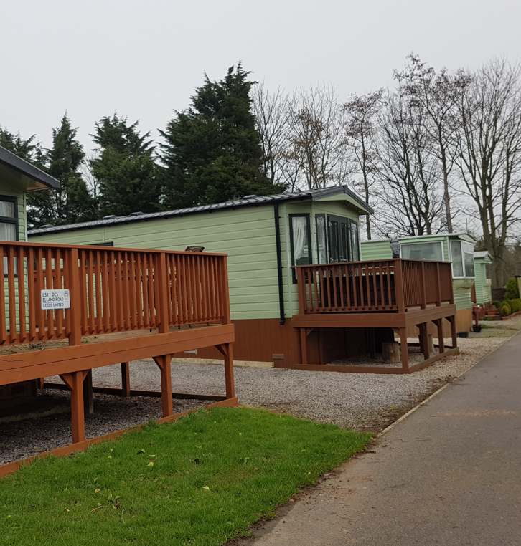
Visiting Farmworker Housing
Not all farmworker housing may be clearly marked or visible. Don't assume a place may not be occupied. Be sure to keep your eyes open and look for housing you might otherwise have missed.
Previously, recruiters have found farmworker housing by following power lines into fields, by finding trash cans placed at the ends of roads, and by visiting houses they thought were abandoned.

Slide 19
Visiting Farmworker Housing
Farmworker housing is best visited at night, after workers have finished for the day, or early in the morning before they begin working.
If the housing is located on the farm or agribusiness property, always ask permission to visit from someone in charge and inform them when you will be visiting.
Be sure to always carry identification and business cards so you can easily identify yourself.

Slide 20
Visiting Farmworker Housing
There may be many workers living in the same location so be prepared to speak to everyone.
Always ask how many people are living in the house to guarantee you have spoken to everyone.

Slide 21
Visiting Farmworker Housing
While visiting farmworker housing you may need to speak to large groups of workers at the same time.
It is important when speaking to large groups of workers that you clearly demonstrate why you are visiting and who you work for.

Slide 22
Visiting Farmworker Housing
Bring materials you can share and hand out to the group. Having materials to hand out can be a great icebreaker and build trust with workers.
Materials you can share include:
English Books
Bandanas
Gloves
Local resource guides
Anything you think might meet a
need of the farmworkers
Notes:
I would add that it is pretty easy to get different community members and volunteer groups to make these for you! Especially like hygiene kits, kids books, protein bars, etc

Slide 23
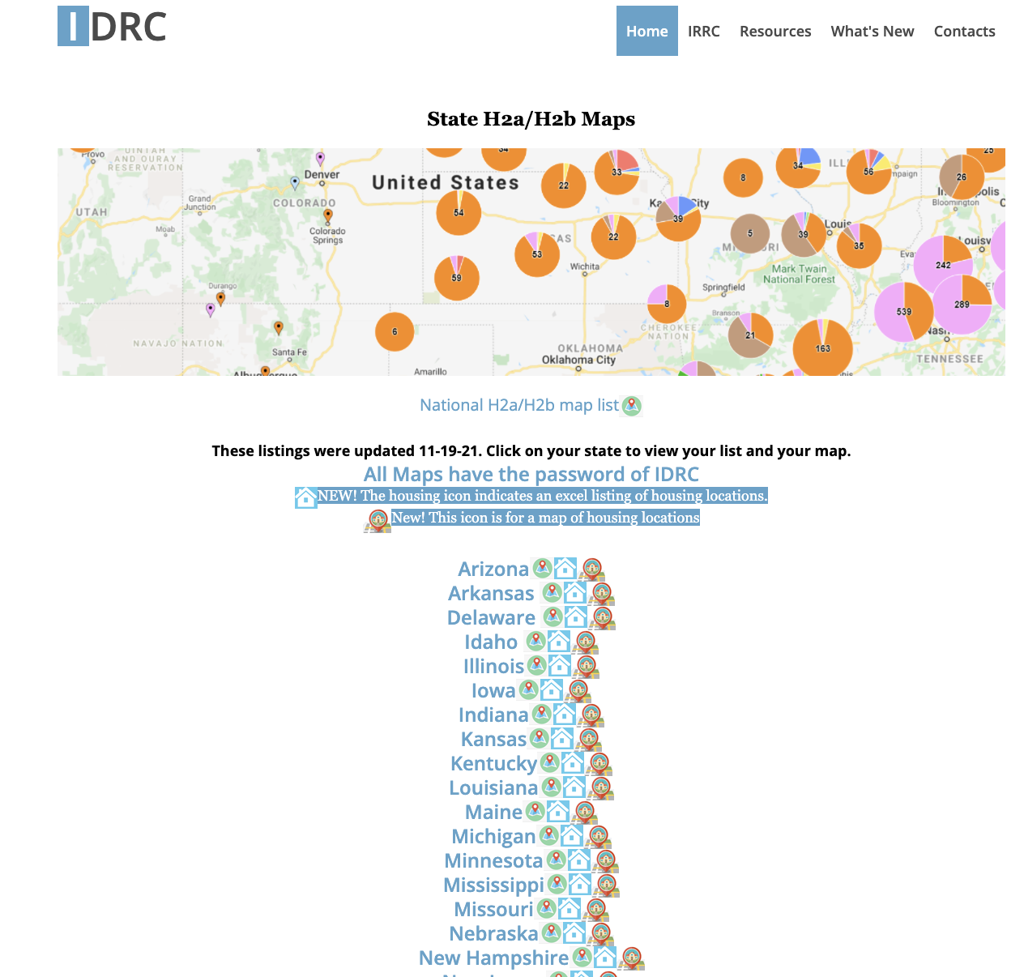
IDRC H2a Housing Maps
One way to find farmworker housing is by reviewing the housing locations on H2A orders.
All farms that bring in H2A workers are legally obligated to provide housing for the workers.
The address and location of H2A housing sites is disclosed on the H2A request form that agribusiness owners fill out.

Slide 24
IDRC H2a Housing Maps
IDRC has collect the H2A housing information for all states and has created downloadable spreadsheets and viewable maps for all 50 states in the country.
To view the H2A housing spreadsheets and maps visit the IDRC website below:
https://www.idr-consortium.net/H2aH2bMaps.html

Slide 25
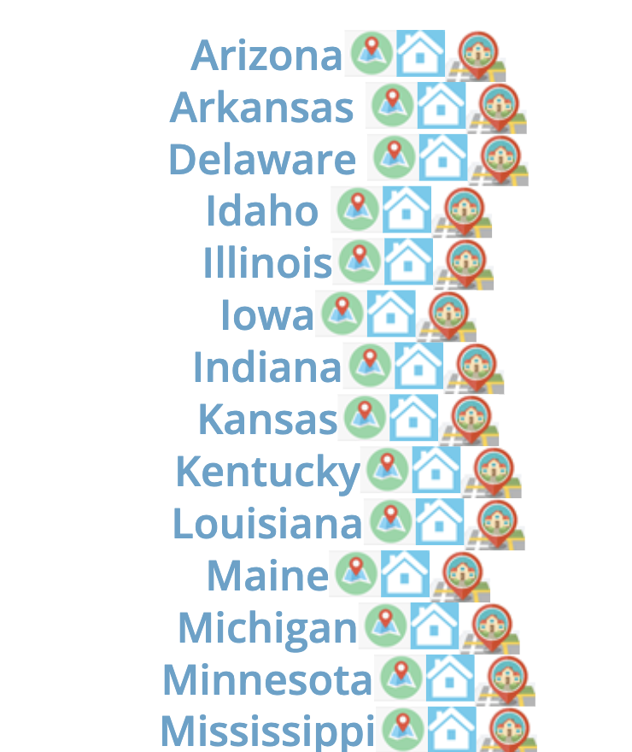
IDRC H2a Housing Maps
If you click on the name of your state, you will be taken to the spreadsheet with all H2A and H2B work Orders in your state.
The second icon is for the BatchGeo map of all H2A and H2B work orders in the state.
https://www.idr-consortium.net/H2aH2bMaps.html

Slide 26
IDRC H2a Housing Maps
The third icon, the blue house, is the link for the spreadsheet containing all H2A housing information for your state.
The fourth icon, the house on a map, is the link for the BatchGeo map of all H2A housing sites in your state
All maps and spreadsheets use the
Password: IDRC.
https://www.idr-consortium.net/H2aH2bMaps.html

Slide 27
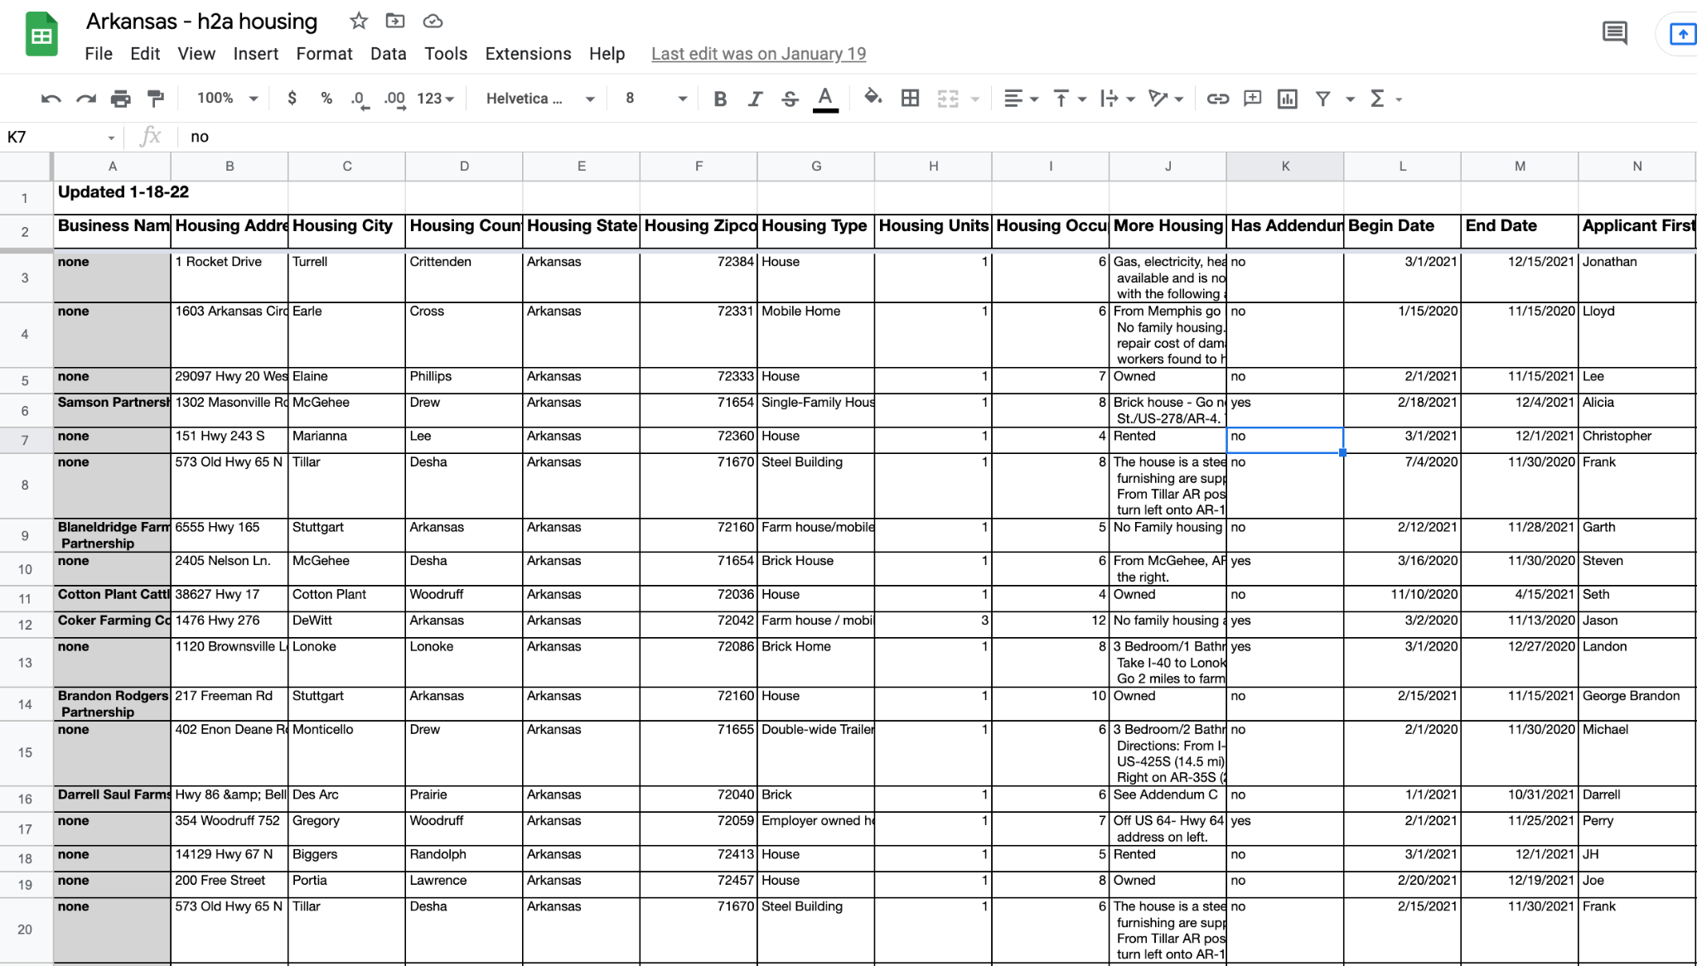
IDRC H2a Housing Maps
You can download the spreadsheet for your state to track which locations you have visited and to create your own maps.
The spreadsheets contain the address of the housing site, any additional housing sites, and how many people are living there.
https://www.idr-consortium.net/H2aH2bMaps.html

Slide 28
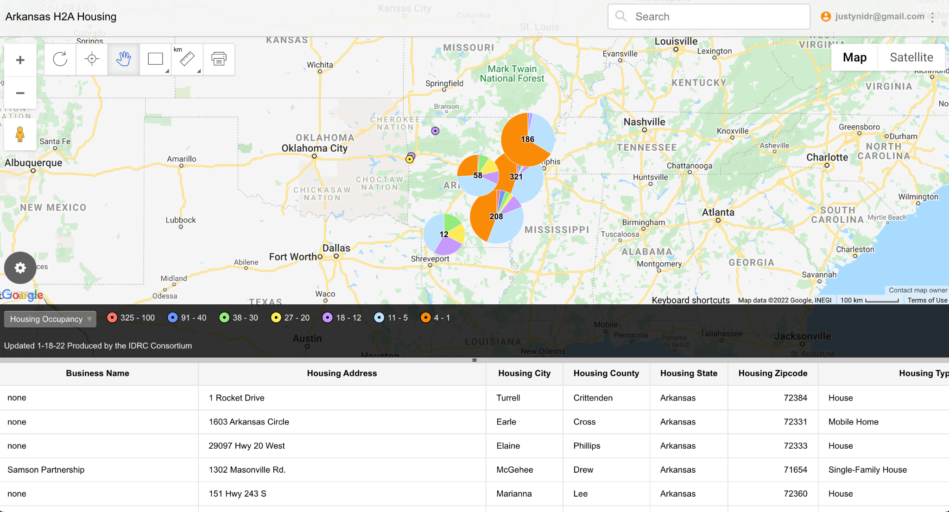
IDRC H2a Housing Maps
The BatchGeo maps can be accessed from both your work computer and your phone.
The locations on the BatchGeo Housing Map are color coded according to how many people are living at that location.
https://www.idr-consortium.net/H2aH2bMaps.html

Slide 29
Visiting Currently Enrolled Families
It is important for recruiters to continue visiting currently enrolled families to check in to see how they are doing and to find potential information that could lead you to new students.
Our currently enrolled families should be our biggest advocates and information gatherers in the field.

Slide 30
Visiting Currently Enrolled Families
If a family does not have a regular service provider, check in regularly with the family to:
See how they are doing
Ensure they do not have any immediate needs that need to be taken care of
To gauge their views of the Migrant Education Program
To see if they have met anyone recently who might
also qualify
To provide them with flyers, brochures, or other
materials they can hand out at the workplace
Notes:
I would just add that sometimes currently enrolled families make qualifying moves and then return but dont think to tell you because they dont think of it as a move. It has happens to me/us several times a year. They might think of say Bamberg as their home, so when they went to Michigan for two weeks, they didnt “move” but it would still be a QAD

Slide 31
Visiting Currently Enrolled Families
It is important to remember that even though you may have spoken to a family in the last couple of weeks, they may have met or encountered someone new who might be eligible.
It is always work asking currently enrolled families for leads or information because they know better than anyone the needs and benefits of the program.

Slide 32
Visiting Currently Enrolled Families
If there is a regular service provider assigned to the family or student, be sure to encourage them to regularly ask the family if they know of anyone who might be eligible
Always encourage the family to be on the lookout for who else might benefit from the Migrant Education Program.

Slide 33
Visiting Old Addresses
Since many migrant students and families return to the same addresses each year or to addresses they have been recommended by other migrant families, it is important to keep track of where people have lived in the past and continue to check in on the addresses to make sure no one new has moved in.

Slide 34
Visiting Old Addresses
When visiting old addresses, always have your identification ready to show who you are, a brochure to explain the program, and any other materials you can share.
Explain in your elevator pitch how you obtained the address and why you are visiting.
Explain you are there because there was a family who previously lived at the address that received assistance and you are there to see if they may also be eligible.

Slide 35
Visiting Old Addresses
Always make sure you have materials that you can pass out and leave behind when visiting old addresses.
Even if the family is not eligible, share any flyers, brochures, or business cards you may have to help the family remember the program in case they are eligible in the future.

Slide 36
Conducting Door-to-Door Effort
One of the best ways to get to know a community and learn as much as possible is by recruiting door-to-door in popular housing sites.
This method of recruitment is often necessary during peak seasons when migrant workers are arriving in large numbers.

Slide 37
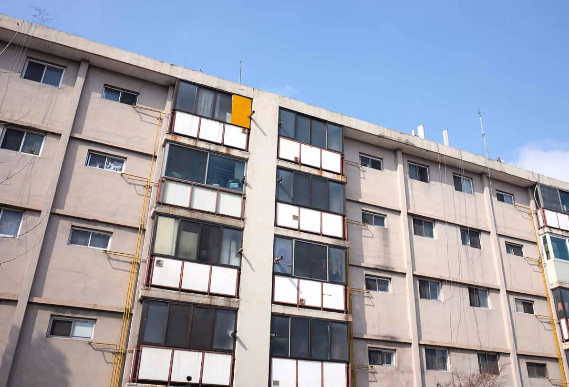
Types of Locations to Go Door-to-Door
Trailer Parks
Neighborhoods
Apartment complexes
Hotels
Campgrounds
Farmworker camps

Slide 38
Conducting Door-to-Door Sweeps
Be sure to carry flyers and door hangers that you can leave behind in case no one answers.
Door hangers are a great tool to let the owner or renter know that someone from the Migrant Education Program stopped by and to provide them with information so they can contact you.

Slide 39
Conducting Door-to-Door Sweeps
Always ask who owns the property or who the family is renting the property from. If you are visiting an apartment complex, hotel, or trailer park then visit the office to speak to management.
Good relationships with property owners or management can provide valuable information and let you know ahead of time when new families are arriving. Many property managers also run multiple properties.

Slide 40
Knowing Where to Look for Housing
You can use the following websites to locate low income housing and housing with high mobility in your area:
Rent.Com
https://www.rent.com/
Mobile Home Village:
https://www.mhvillage.com/parks
Homeland Infrastructure Database:
https://hifld-geoplatform.opendata.arcgis.com/datasets/mobile-home-parks/explore

Slide 41
Conducting Door-to-Door Sweeps
When conducting door-to-door sweeps planning is crucial. Know exactly, which houses or doors you will be knocking on and provide yourself enough time to guarantee that you can talk to who you need to talk to.
If you are covering a large area use Google Maps to create a map that can help keep you organized.
Notes:
-add that while you dont HAVE to go with others, this can be a good time to go out with a similar outreach team (pro being you keep each other company and fresh, and have more to offer the family, con being students/families/community members might get confused about who you are one of you may spend a lot of time talking to non-qualifying folks)

Slide 42
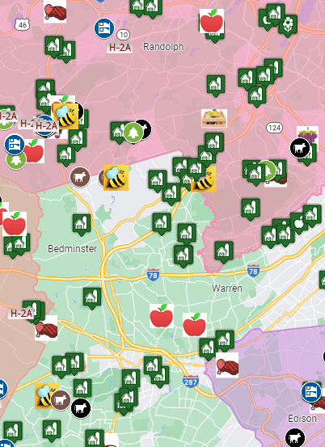
Conducting Door-to-Door Sweeps
When creating your plan, always use the data that is available to you to help you make informed decisions.
Look at your currently enrolled families addresses, old addresses, farmworker addresses, and anything you have gained from your research to begin creating your plan.

Slide 43
Conducting Door-to-Door Sweeps
Look for patterns in the addresses in order to identify the locations that would be ideal options for going door-to-door.
Look for areas where there are several migrant students, locations close to farms, or where several migrant families previously have lived.
The more addresses that you find that are close together, the better the location is as an option to go door-to-door.

Slide 44
Conducting Door-to-Door Sweeps
When knocking on the door of someone who you may not know, it is important to be ready to introduce yourself and prove you are not there to sell anything.
Most people when answering the door will first believe that it is a solicitor or salesperson.

Slide 45
Conducting Door-to-Door Efforts
Always have your elevator pitch prepared and ready to go to help you start conversation with the person who answers the door and to help build trust.
Having a script that you are familiar and comfortable with makes the process of going door-to-door much easier and makes it more likely for the interview to be successful.

Slide 46
Conducting Door-to-Door Sweeps
Always commit to a positive attitude and do not let yourself get discouraged no matter what the response. A smile and good attitude can go a long way to helping you gain valuable information.
Remember, if someone responds to you negatively you are rarely the problem. Forget about the negative response and move on to the next location.

